Slide 1
Smart Parking System
Group Members:
Sayli Sawant
Vaidehi Phaltankar
Aaryaa Padhyegurjar
Nikita Patel

Slide 2
Problem Statement
Urban life requires centralized public facilities.
Hardly any car parking facilities that are used today are able to cope up with the influx of vehicles.
Searching for a vacant parking space is time consuming
It results in more traffic congestion because many vehicles may go after limited parking spaces

Slide 3
Proposed Solution
Smart Parking System is used to assist drivers to find vacant spaces in a car park in a shorter time.
The basic facilities required to fulfill our requirements are:
Location of the car park should be easy to find
Entrance should be easy to discover
Parking lots should should be in abundance
This will include:
Automated parking system without any manual labour
Simultaneous operations on different floors for car parking.
Multiple entry and exit points.
Pre-booking of parking slots through a Mobile App

Slide 4
Hardware Components
STM 32FC | It is used as a microcontroller
UV Sensors | Used to count number of cars entering and to control servo motor
IR Sensors | Used to differentiate used and empty parking spots
Servo Motor | Shaft moves up when it receives signal from UV
Camera** | Used to categorize different vehicles based on size
LCD Display** | Used to display vacancies in the parking lot
** Not Tested yet

Slide 5
Software Used
Arduino IDE
Thunkable Classic for Android App development
Anaconda-OpenCV Python for Image Processing

Slide 6
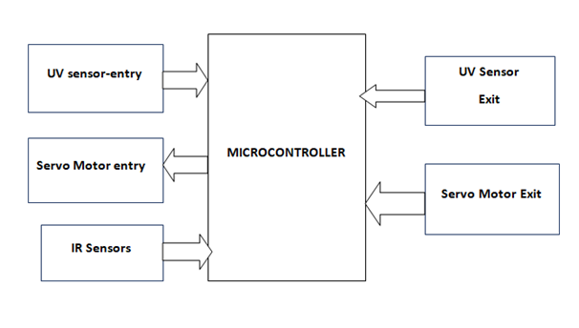
Block Diagram

Slide 7
Working:
When a vehicle arrives in front of UV sensor it sends a signal to servo motor which rotates 90 degrees up and allows the car to enter inside.
Once the capacity of the system is full no more vehicle is allowed inside.
The exit and entry system work simultaneously with the help of a counter which increments or decrements as a vehicle enters or leaves the parking slot.
The IR sensors help to identify filled and empty spaces.

